Slide 1
Data warehouse
Course outcome:
CO1: Understand Data Warehouse fundamentals, Data Mining Principles
CO2. Design data warehouse with dimensional modelling and apply OLAP operations.

Slide 2
An Environment, Not a Product
A data warehouse is not a single software or hardware product you purchase to provide strategic information. It is, rather, a computing environment where users can find strategic information, an environment where users are put directly in touch with the data they need to make better decisions. It is a user-centric environment.
Let us summarize the characteristics of this new computing environment called the data warehouse:
An ideal environment for data analysis and decision support Fluid, flexible, and interactive
100 percent user-driven
Very responsive and conducive to the ask–answer–ask–again pattern
Provides the ability to discover answers to complex, unpredictable questions

Slide 3
A Blend of Many Technologies
Let us reexamine the basic concept of data warehousing. The basic concept of data warehousing is:
Take all the data from the operational systems
Where necessary, include relevant data from outside, such as industry benchmark indicators
Integrate all the data from the various sources Remove inconsistencies and transform the data
Store the data in formats suitable for easy access for decision making

Slide 4
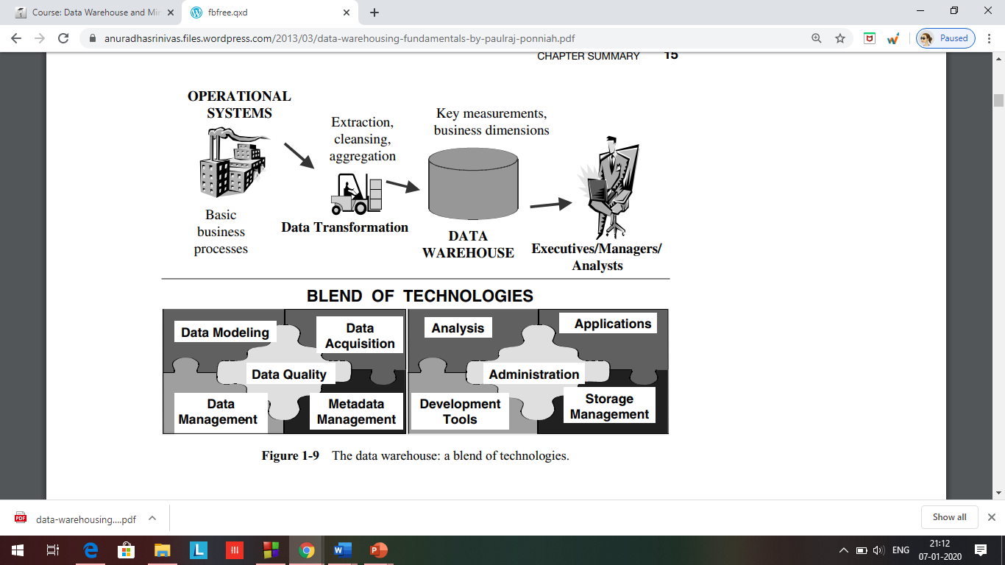

Slide 5
Definition:
Bill Inmon, considered to be the father of Data Warehousing provides the following definition:
“A Data Warehouse is a subject oriented, integrated, nonvolatile, and time variant collection of data in support of management’s decisions.”

Slide 6
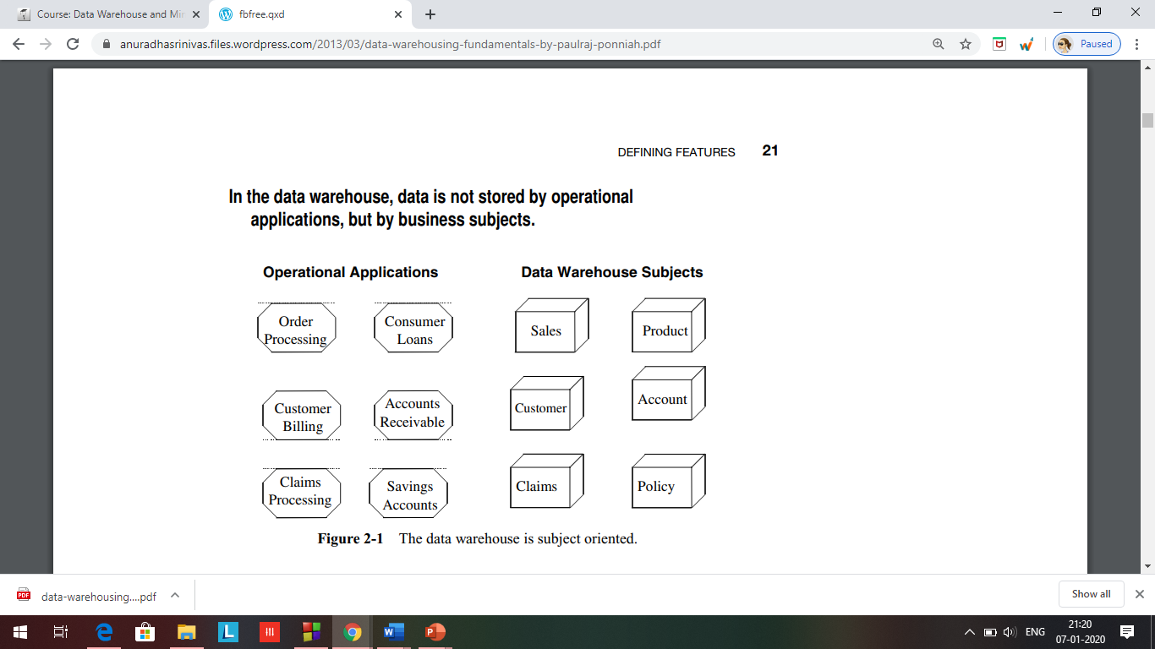
Subject Oriented?

Slide 7
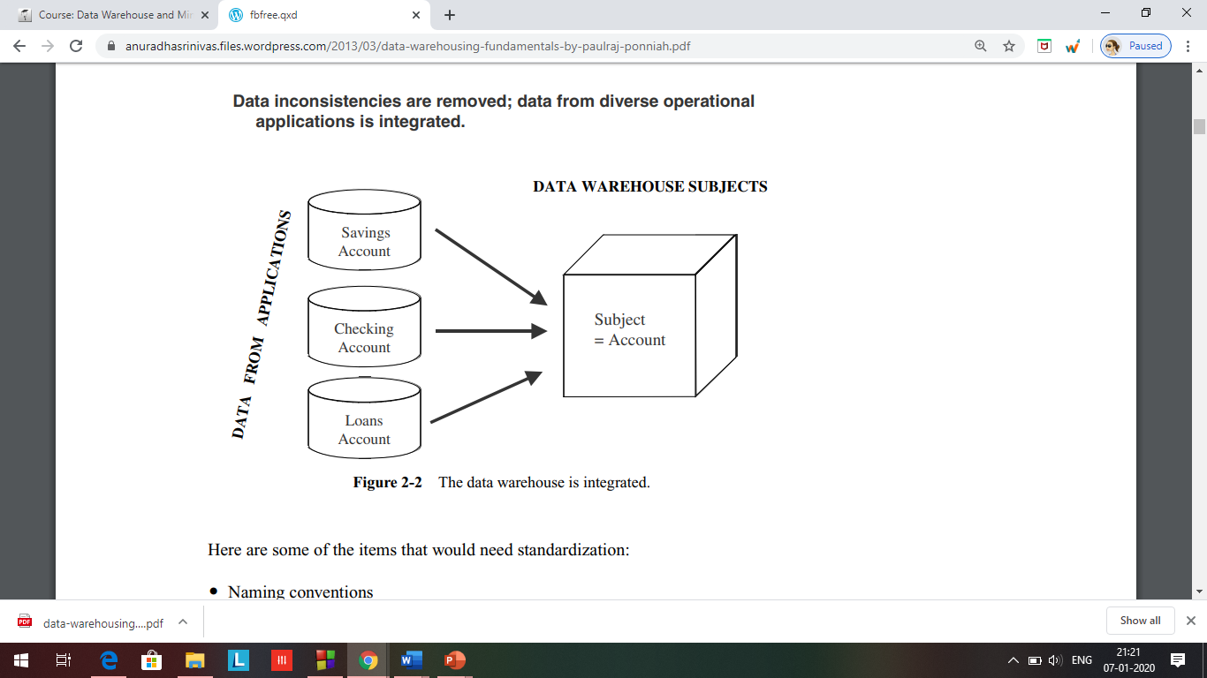
Integrated data?

Slide 8
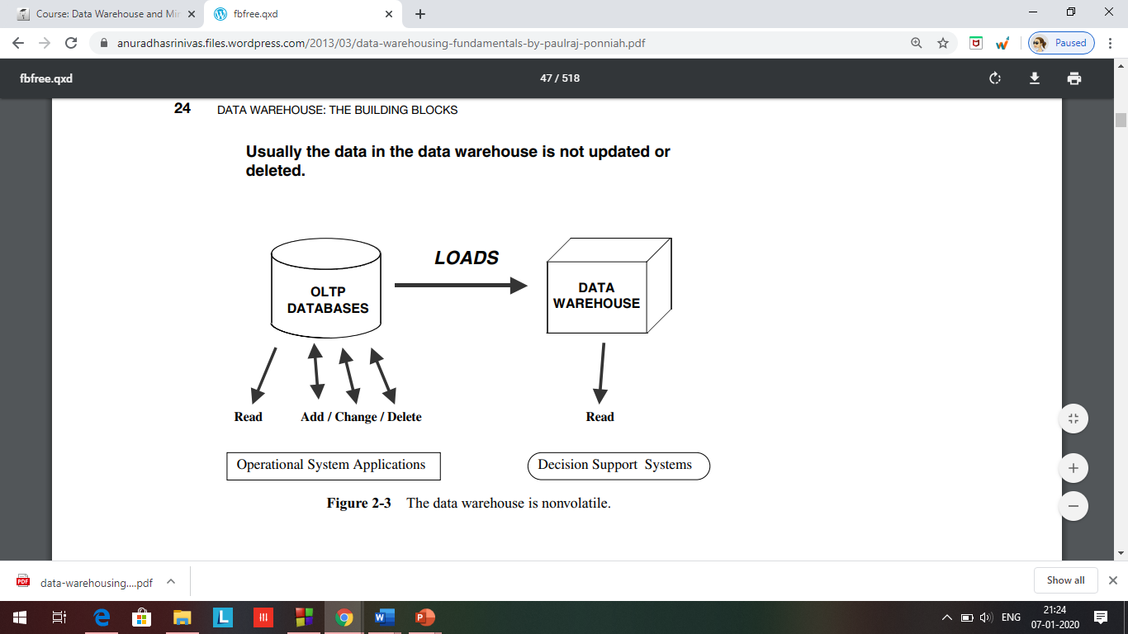
Non volatile?

Slide 9
Time variant?
A data warehouse, because of the very nature of its purpose, has to contain historical data, not just current values. Data is stored as snapshots over past and current periods. Every data structure in the data warehouse contains the time element.

Slide 10
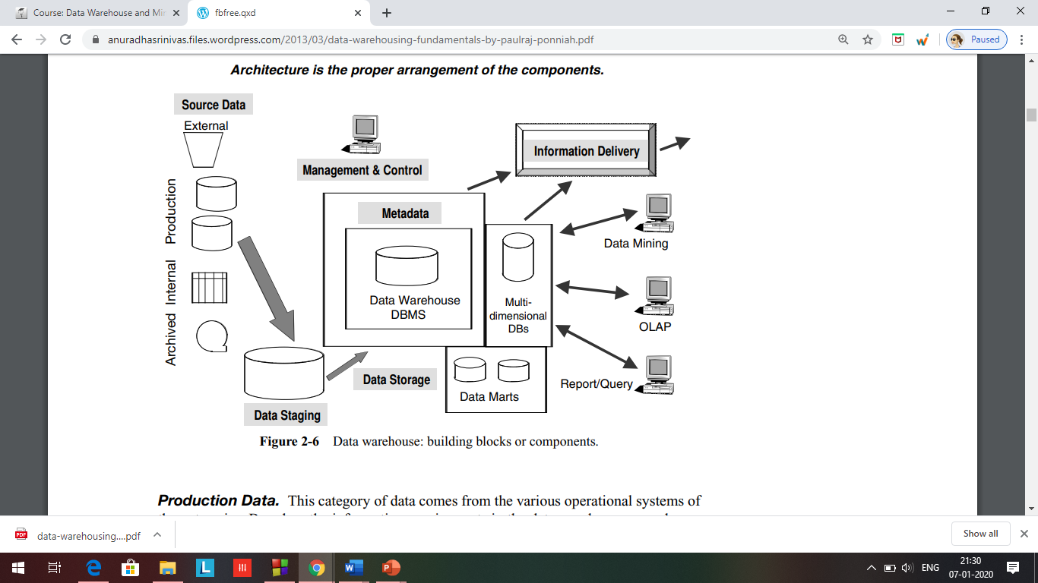
Building blocks of data warehouse

Slide 11
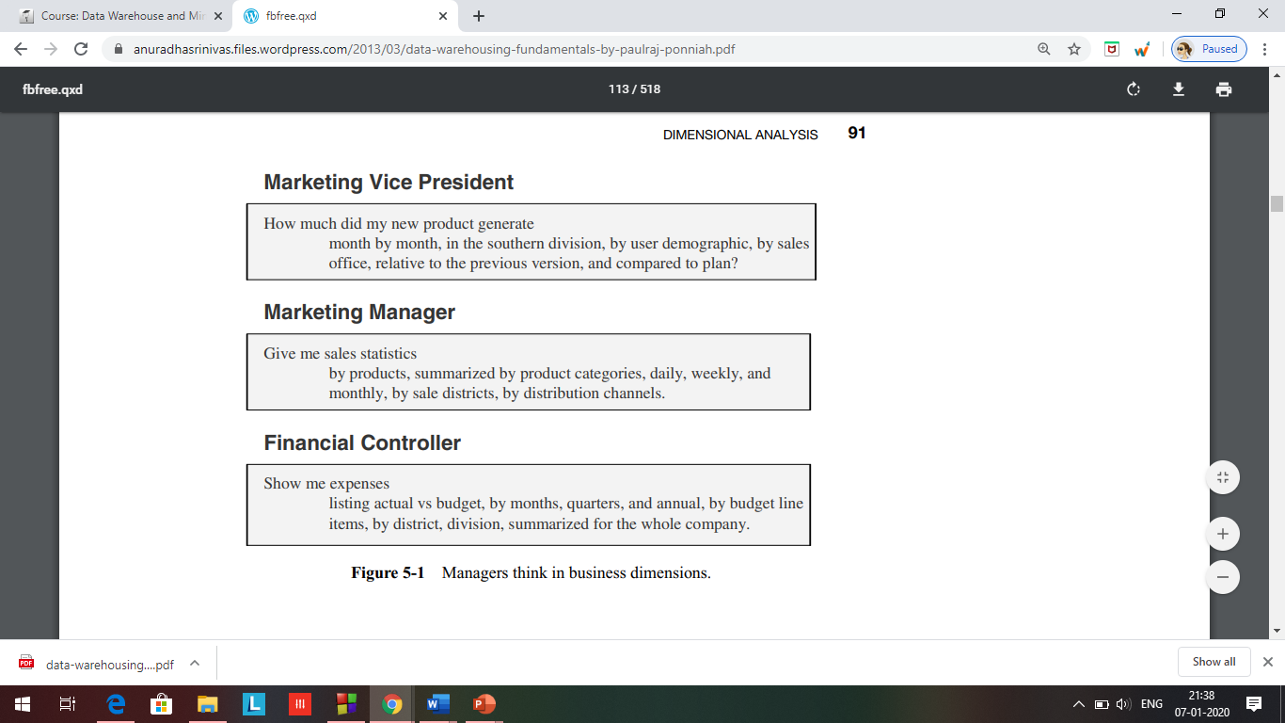
DIMENSIONAL ANALYSIS Managers think of the business in terms of business dimensions.
If your users of the data warehouse think in terms of business dimensions for decision making, you should also think of business dimensions while collecting requirements.

Slide 12
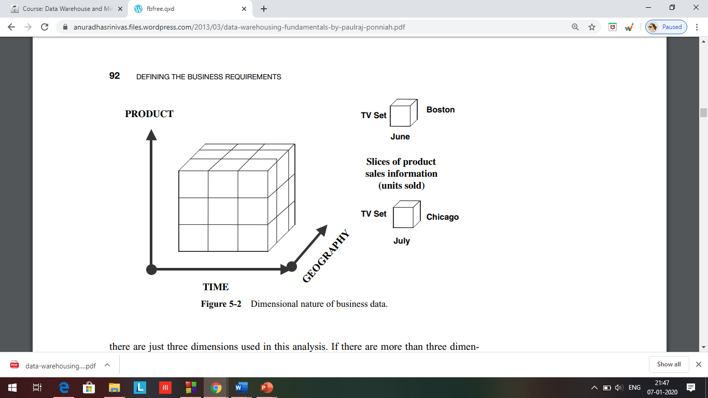

Slide 13
For the supermarket chain,
The measurements that are analyzed are the sales units.
These are analyzed along four business dimensions.
When you are looking for the hypercubes, the sides of such cubes are time, promotion, product, and store.
If you are the Marketing Manager for the supermarket chain, you would want your sales broken down by product, at each store, in time sequence, and in relation to the promotions that take place.

Slide 14
For the insurance company,
the business dimensions are different and appropriate for that business.
Here you would want to analyze the claims data by agent, individual claim, time, insured party, individual policy, and status of the claim.

Slide 15
Airlines company:
Dimensions for analysis of frequent flyer data.
Here the business dimensions are time, customer, specific flight, fare class, airport, and frequent flyer status.

Slide 16
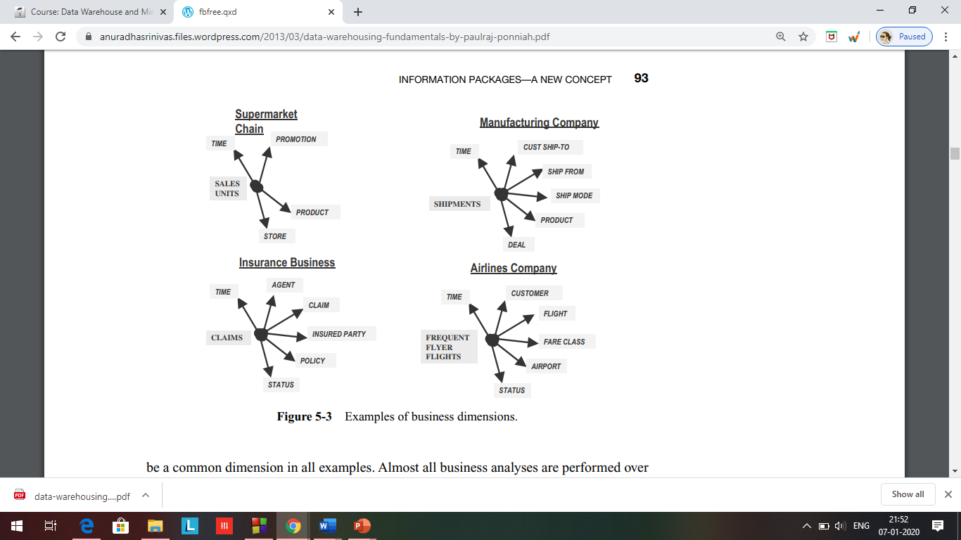

Slide 17
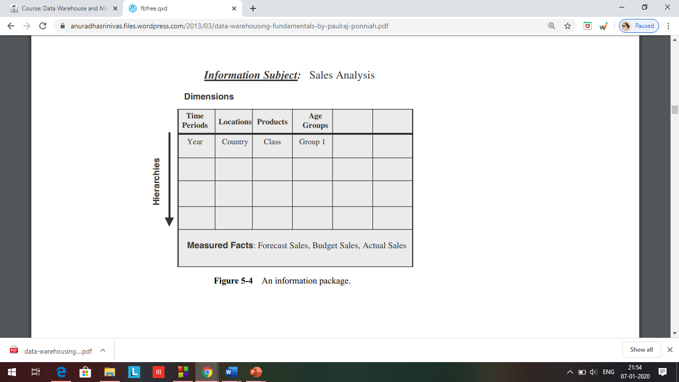
IPD
information packages enable you to:
Define the common subject areas
Design key business metrics
Decide how data must be presented
Determine how users will aggregate or roll up
Decide the data quantity for user analysis or query
Decide how data will be accessed
Establish data granularity
Estimate data warehouse size
Determine the frequency for data refreshing
Ascertain how information must be packaged

Slide 18
Dimension Hierarchies/Categories
When a user analyzes the measurements along a business dimension, the user usually would like to see the numbers first in summary and then at various levels of detail. What the user does here is to traverse the hierarchical levels of a business dimension for getting the details at various levels.
Hierarchies and categories are included in the information packages for each dimension.
Product: Model name, model year, package styling, product line, product category, exterior color, interior color, first model year
Dealer: Dealer name, city, state, single brand flag, date first operation
Customer demographics: Age, gender, income range, marital status, household size, vehicles owned, home value, own or rent
Payment method: Finance type, term in months, interest rate, agent
Time: Date, month, quarter, year, day of week, day of month, season, holiday flag

Slide 19
Hotel occupancy analysis:
We have included three business dimensions.
Let us list the possible hierarchies and categories for the three dimensions.
Hotel: Hotel line, branch name, branch code, region, address, city, state, Zip Code, manager, construction year, renovation year
Room type: Room type, room size, number of beds, type of bed, maximum occupants, suite, refrigerator, kitchenette
Time: Date, day of month, day of week, month, quarter, year, holiday flag

Slide 20
Key Business Metrics or Facts
Using business dimensions, what exactly are the users analyzing? What numbers are they analyzing?
The numbers the users analyze are the measurements or metrics that measure the success of their departments.
These are the facts that indicate to the users how their departments are doing in fulfilling their departmental objectives.
Actual sale price
MSRP sale price
Options price
Full price
Dealer add-ons
Dealer credits
Dealer invoice
Amount of down payment
Analyzing automobile sales is as:

Slide 21
Example of hotel occupancy
Occupied rooms
Vacant rooms
Unavailable rooms
Number of occupants
Revenue

Slide 22
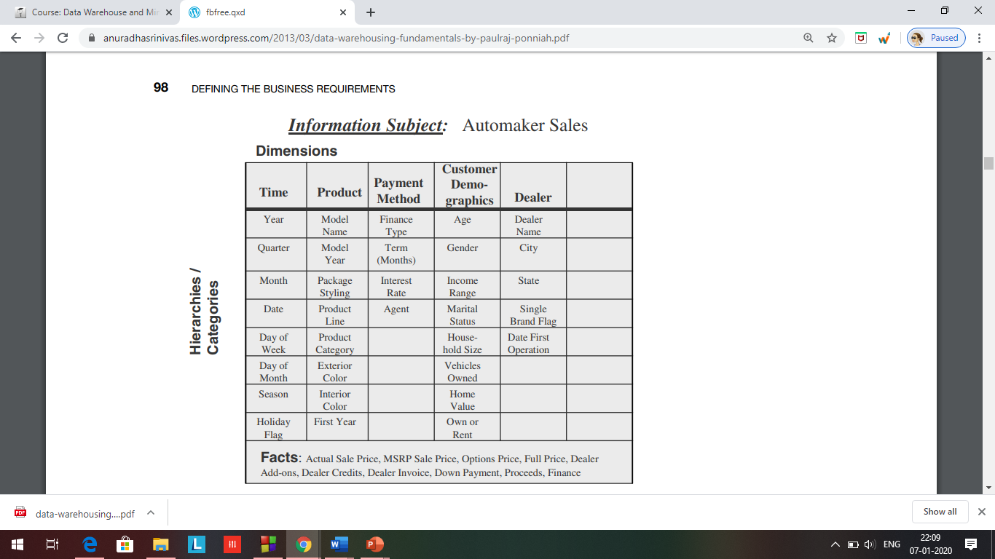
Complete IPD
Information Subject: Automaker sales

Slide 23
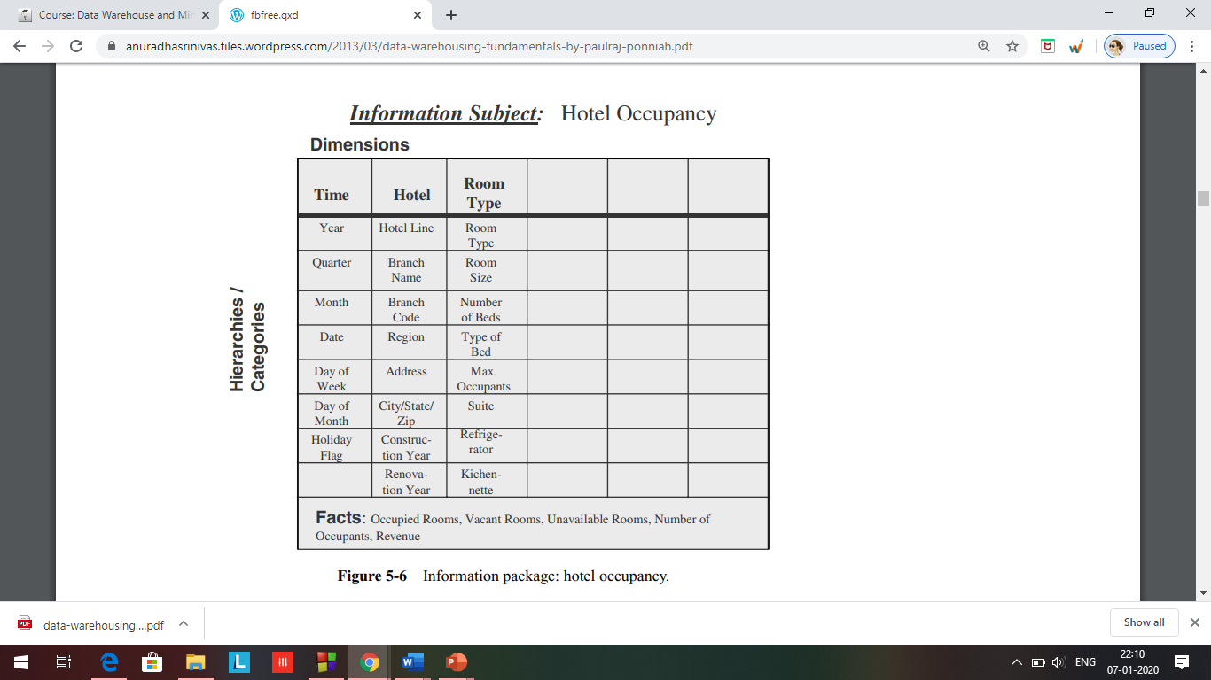
Hotel Occupancy IPD

Slide 24
Design Decisions Before we proceed with designing the dimensional data model, let us quickly review some of the design decisions you have to make:
Choosing the process: Selecting the subjects from the information packages for the first set of logical structures to be designed.
Choosing the grain: Determining the level of detail for the data in the data structures.
Identifying and conforming the dimensions: Choosing the business dimensions (such as product, market, time, etc.) to be included in the first set of structures and making sure that each particular data element in every business dimension is conformed to one another.
Choosing the facts: Selecting the metrics or units of measurements (such as product sale units, dollar sales, dollar revenue, etc.) to be included in the first set of structures.
Choosing the duration of the database: Determining how far back in time you should go for historical data.

Slide 25
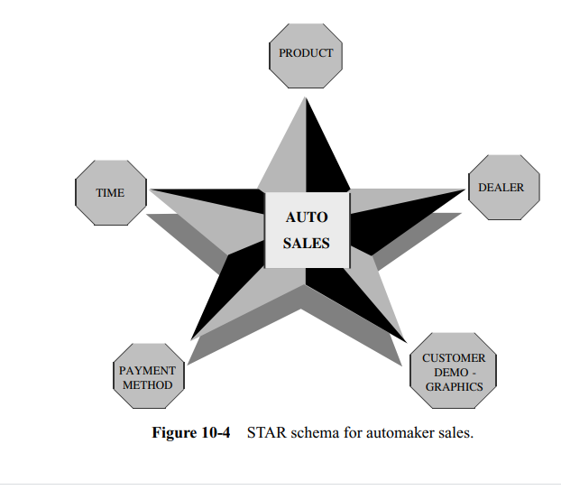
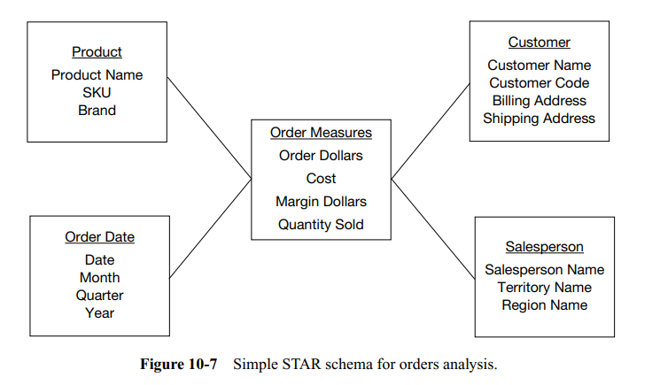
Star schema
The structure mirrors how the users normally view their critical measures along their business dimensions. When you look at the order dollars, the STAR schema structure intuitively answers the questions of what, when, by whom, and to whom. From the STAR schema, the users can easily visualize the answers to these questions: For a given amount of dollars, what was the product sold? Who was the customer? Which salesperson brought the order? When was the order placed?

Slide 26
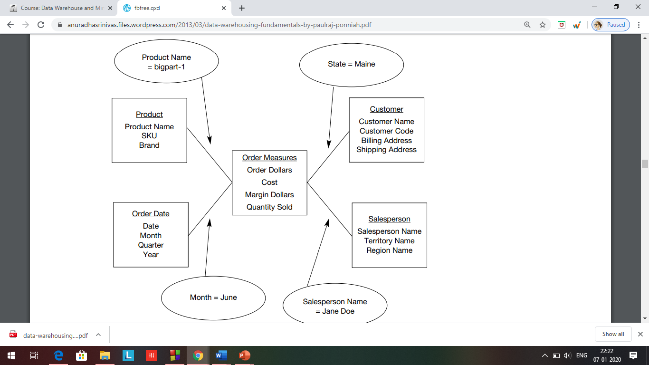

Slide 27
Star schema
Most popular schema
Dimensions are stored in dimension table and every entry has unique identifier(primary key)
All unique identifiers from dimension table makeup for a composite key in the fact table
Fact table also contains fact
Thus eg store_id, date_key, and product_id giving the amount of a certain product sold on a certain date in particular store
Foreign keys for the dimension tables are contained in fact table.
Size of fact table is very large as compared to dimension table
Fully Denormalized thus few joins and faster Query Operation

Slide 28
Sales star schema
Time dimension table
Time_key (PK)
day
Day_of_the_week
month
quarter
year
Item dimension table
item_key
Item_name
brand
type
Supplier_type
Sales fact table
Time_key (FK)
Item_key (FK)
Branch_key (FK)
Location_key (FK)
Units_sold
Dollars_sold
Avg_sales
Location dimension table
location_key
street
city
state
country
branch dimension
Branch_key
Branch_name
Branch_type

Slide 29
Inside the dimension table
Dimension table key. Primary key of the dimension table uniquely identifies each row in the table.
Table is wide: Typically, a dimension table has many columns or attributes. It is not uncommon for some dimension tables to have more than fifty attributes. Therefore, we say that the dimension table is wide. If you lay it out as a table with columns and rows, the table is spread out horizontally.
Textual attributes. In the dimension table you will seldom find any numerical values used for calculations. The attributes in a dimension table are of textual format.
Attributes not directly related: Frequently you will find that some of the attributes in a dimension table are not directly related to the other attributes in the table. For example, package size is not directly related to product brand; nevertheless, package size and product brand could both be attributes of the product dimension table.
Not normalized: The attributes in a dimension table are used over and over again in queries. An attribute is taken as a constraint in a query and applied directly to the metrics in the fact table. For efficient query performance, it is best if the query picks up an attribute from the dimension table and goes directly to the fact table and not through other intermediary tables. If you normalize the dimension table, you will be creating such intermediary tables and that will not be efficient. Therefore, a dimension table is flattened out, not normalized.
Drilling down,rolling up:The attributes in a dimension table provide the ability to get to the details from higher levels of aggregation to lower levels of details. For example, the three attributes zip, city, and state form a hierarchy. You may get the total sales by state, then drill down to total sales by city, and then by zip. Going the other way, you may first get the totals by zip, and then roll up to totals by city and state.
Multiple hierarchies.:In the example of the customer dimension, there is a single hierarchy going up from individual customer to zip, city, and state. But dimension tables often provide for multiple hierarchies, so that drilling down may be performed along any of the multiple hierarchies. Take for example a product dimension table for a department store. In this business, the marketing department may have its way of classifying the products into product categories and product departments. On the other hand, the accounting department may group the products differently into categories and product departments. So in this case, the product dimension table will have the attributes of marketing–product–category, marketing–product–department, finance–product–category, and finance–product–department.
Fewer number of records:A dimension table typically has fewer number of records or rows than the fact table. A product dimension table for an automaker may have just 500 rows. On the other hand, the fact table may contain millions of rows.

Slide 30
Inside the fact table
Concatenated Key.: A row in the fact table relates to a combination of rows from all the dimension tables.
Data Grain: This is an important characteristic of the fact table. As we know, the data grain is the level of detail for the measurements or metrics.
Fully Additive Measures. In a certain query, let us say that the user wants the totals for the particular product on a certain date, not for a specific customer, but for customers in a particular state. Then we need to find all the rows in the fact table relating to all the customers in that state and add the order_dollars, extended_cost, and quantity_ordered to come up with the totals. The values of these attributes may be summed up by simple addition. Such measures are known as fully additive measures. Aggregation of fully additive measures is done by simple addition. When we run queries to aggregate measures in the fact table, we will have to make sure that these measures are fully additive. Otherwise, the aggregated numbers may not show the correct totals.
Semi-additive Measures: Consider the margin_dollars attribute in the fact table. For example, if the order_dollars is 120 and extended_cost is 100, the margin_percentage is 20. This is a calculated metric derived from the order_dollars and extended_ cost. If you are aggregating the numbers from rows in the fact table relating to all the customers in a particular state, you cannot add up the margin_percentages from all these rows and come up with the aggregated number.

Slide 31
Inside the fact table(cont)
Table Deep, Not Wide: Typically a fact table contains fewer attributes than a dimension table. Usually, there are about 10 attributes or less. But the number of records in a fact table is very large in comparison. Take a very simplistic example of 3 products, 5 customers, 30 days, and 10 sales representatives represented as rows in the dimension tables. Even in this example, the number of fact table rows will be 4500, very large in comparison with the dimension table rows. If you lay the fact table out as a two-dimensional table, you will note that the fact table is narrow with a small number of columns, but very deep with a large number of rows.
Sparse Data. We have said that a single row in the fact table relates to a particular product, a specific calendar date, a specific customer, and an individual sales representative. In other words, for a particular product, a specific calendar date, a specific customer, and an individual sales representative, there is a corresponding row in the fact table. What happens when the date represents a closed holiday and no orders are received and processed? The fact table rows for such dates will not have values for the measures. Also, there could be other combinations of dimension table attributes, values for which the fact table rows will have null measures. Do we need to keep such rows with null measures in the fact table? There is no need for this. Therefore, it is important to realize this type of sparse data and understand that the fact table could have gaps.

Slide 32
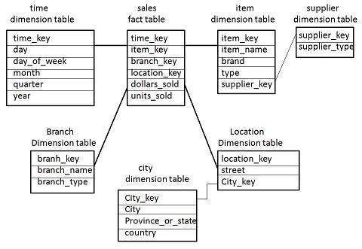
The Snowflake Schema
Used to remove low cardinality i.e attributes having low distinct values, textual attributes from dimension table and placing them in secondary table
If all the dimension tables are normalized then it is called snowflake schema and if few dimension tables are normalized then it is called star flake schema

Slide 33
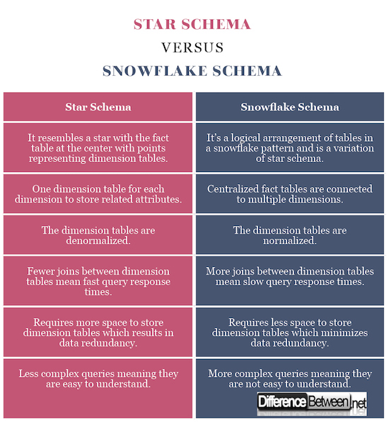

Slide 34
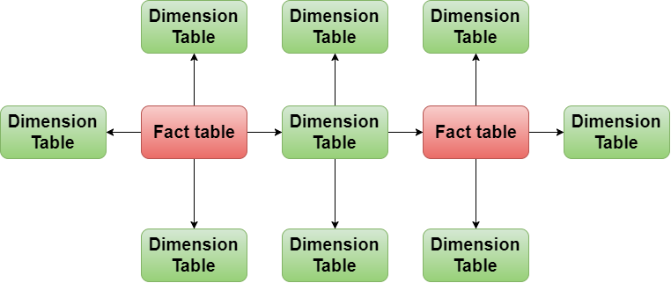
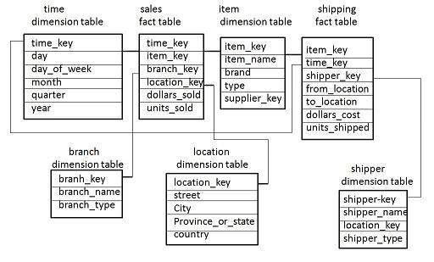
Fact Constellation Schema

Slide 35
Factless Fact table: It captures events that happen only at information level but not included in the calculations level. Just an information about an event that happen over a period.
Identifying product promotion events (to determine promoted products that didn't sell)
Tracking student attendance or registration events.
Tracking insurance-related accident events.
Identifying building, facility, and equipment schedules for a hospital or university.
Factless fact tables are used for tracking a process or collecting stats. They are called so because, the fact table does not have aggregatable numeric values or information.

Slide 36
UPDATES TO THE DIMENSION TABLES
Unlike the fact table, which changes through the increase in the number of rows, a dimension table does not change just through the increase in the number of rows, but also through changes to the attributes themselves
The product dimension table:
Every year, rows are added as new models become available. But what about the attributes within the product dimension table? If a particular product is moved to a different product category, then the corresponding values must be changed in the product dimension table

Slide 37
Slowly Changing Dimensions
Change to the product dimension table because the product category for a product was changed.
Customer’s status changes from rental home to own home
Finance type changes for one of the payment methods

Slide 38
From the consideration of the changes to the dimension tables, we can derive the following principles:
Most dimensions are generally constant over time
Many dimensions, though not constant over time, change slowly
The product key of the source record does not change
The description and other attributes change slowly over time
In the source OLTP systems, the new values overwrite the old ones
Overwriting of dimension table attributes is not always the appropriate option in a data warehouse
The ways changes are made to the dimension tables depend on the types of changes and what information must be preserved in the data warehouse

Slide 39
Type 1 changes, Type 2 changes, and Type 3 changes.
Type 1 Changes: Correction of Errors->
corrections of errors in the source systems
spelling error in the customer name
marital status changed from single to married
Sometimes the change in the source system has no significance
The old value in the source system needs to be discarded
The change in the source system need not be preserved in the data warehouse

Slide 40
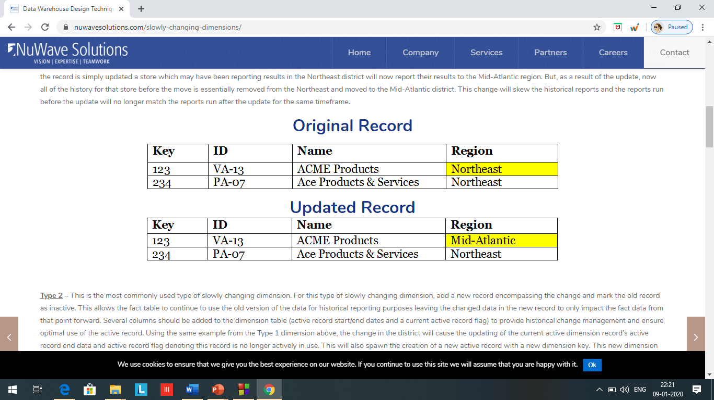
The method for applying Type 1 changes is:
Overwrite the attribute value in the dimension table row with the new value
The old value of the attribute is not preserved
No other changes are made in the dimension table row
The key of this dimension table or any other key values are not affected
This type is easiest to implement

Slide 41
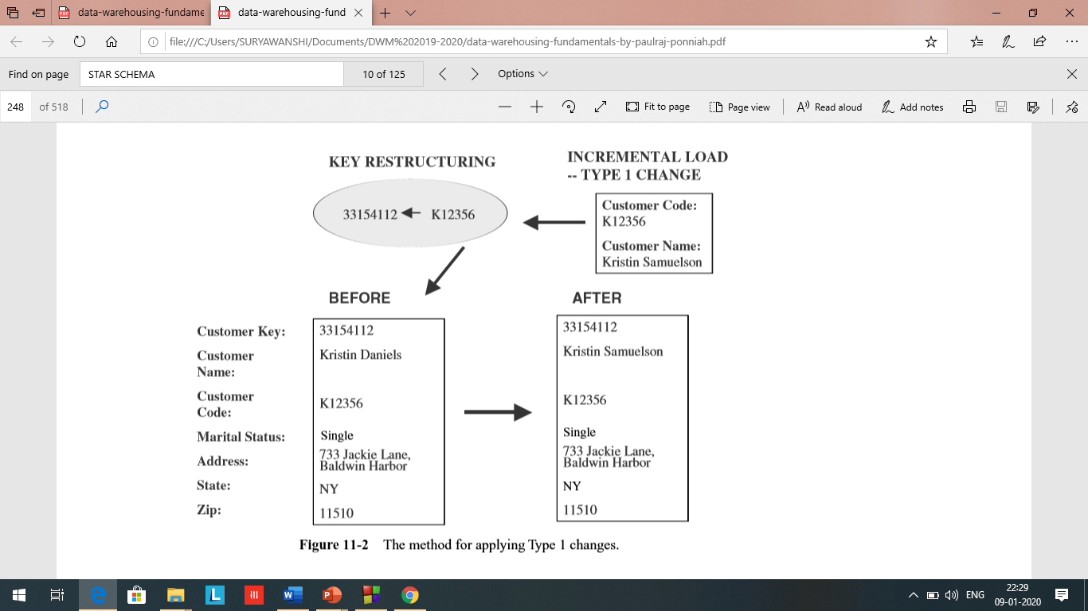

Slide 42
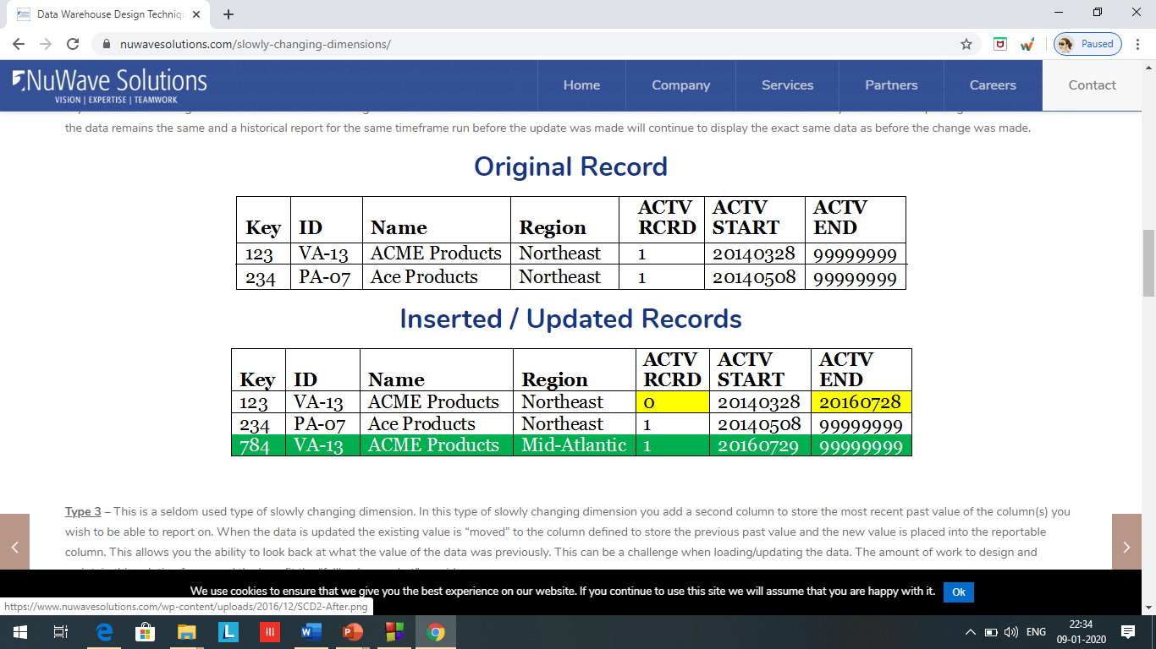
Type 2 Changes: Preservation of History
In the data warehouse, you must have a way of separating the orders for the customer so that the orders before and after that date can be added up separately
The types of changes for marital status and customer address are Type 2 changes.
Here are the general principles for this type of change:
They usually relate to true changes in source systems
There is a need to preserve history in the data warehouse
This type of change partitions the history in the data warehouse
Every change for the same attribute must be preserved

Slide 43
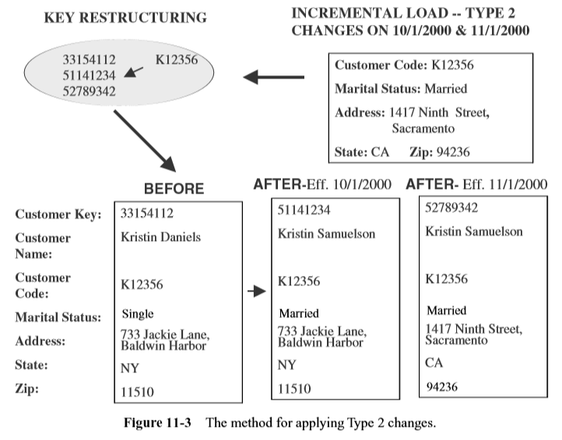
The method for applying Type 2 changes is:
Add a new dimension table row with the new value of the changed attribute
An effective date field may be included in the dimension table
There are no changes to the original row in the dimension table
The key of the original row is not affected
The new row is inserted with a new surrogate key

Slide 44
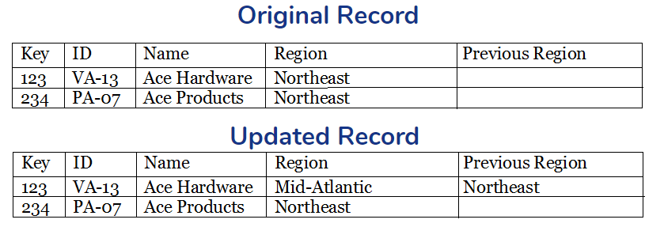
Type 3 Changes: Tentative Soft Revisions
They usually relate to “soft” or tentative changes in the source systems
There is a need to keep track of history with old and new values of the changed attribute
They are used to compare performances across the transition
They provide the ability to track forward and backward

Slide 45
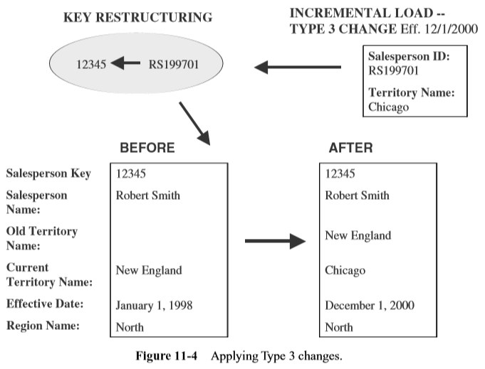
The methods for applying Type 3 changes are:
Add an “old” field in the dimension table for the affected attribute
Push down the existing value of the attribute from the “current” field to the “old” field
Keep the new value of the attribute in the “current” field
Also, you may add a “current” effective date field for the attribute
The key of the row is not affected

Slide 46
Cont..
No new dimension row is needed
The existing queries will seamlessly switch to the “current” value
Any queries that need to use the “old” value must be revised accordingly
The technique works best for one “soft” change at a time
If there is a succession of changes, more sophisticated techniques must be devised

Slide 47
Large Dimensions: Dimension table which are deep and wide
Rapidly changing or large slowly changing dimensions
Type 2 changes are feasible in case infrequent changes like once or twice in a year, eg. Product dimension
Type 2 changes are infeasible or problematic in case dimension table changes infrequently where number of rows are millions like customer dimensions, then we can break the dimension table into one or more mini dimension table.
Cust_dimension
Cust_id
Cust_name
Cust_add
Cust_city
Retail_sales
Product_id
Cust_id
Cust_demo key
Emp_id
Date_id
Sale_rev
Avg_sales
Cust_dimension
Cust_id
Cust_name
Cust_add
Cust_city
Age
Income
Rating
Credit history
Account status
weight
Retail_sales
Product_id
Cust_id
Emp_id
Date_id
Sale_rev
Avg_sales
Cust_demographic dimension
cust_demo key
Age
Income
Rating
Credit history
Account status
weight
Fast changing attribute

Slide 48
Aggregate fact tables
Aggregates are precalculated summaries derived from the most granular fact table.
These summaries form a set of separate aggregate fact tables. You may create each aggregate fact table as a specific summarization across any numb
Query 1: Total sales for customer number 12345678 during the first week of December 2000 for product dimensions.
Query 2: Total sales for customer number 12345678 during the first three months of 2000 for product Widget-1.
Query 3: Total sales for all customers in the South-Central territory for the first two quarters of 2000 for product category Bigtools.

Slide 49
Query 1: All fact table rows where the customer key relates to customer number 12345678, the product key relates to product Widget-1, and the time key relates to the seven days in the first week of December 2000. Assuming that a customer may make at most one purchase of a single product in a single day, only a maximum of 7 fact table rows participate in the summation.
Query 2: All fact table rows where the customer key relates to customer number 12345678, the product key relates to product Widget-1, and the time key relates to about 90 days of the first quarter of 2000. Assuming that a customer may make at most one purchase of a single product in a single day, only about 90 fact table rows or less participate in the summation.
Query 3: All fact table rows where the customer key relates to all customers in the South-Central territory, the product key relates to all products in the product category Bigtools, and the time key relates to about 180 days in the first two quarters of 2000. In this case, clearly a large number of fact table rows participate in the summation
What can be done to reduce the query3 time?

Slide 50
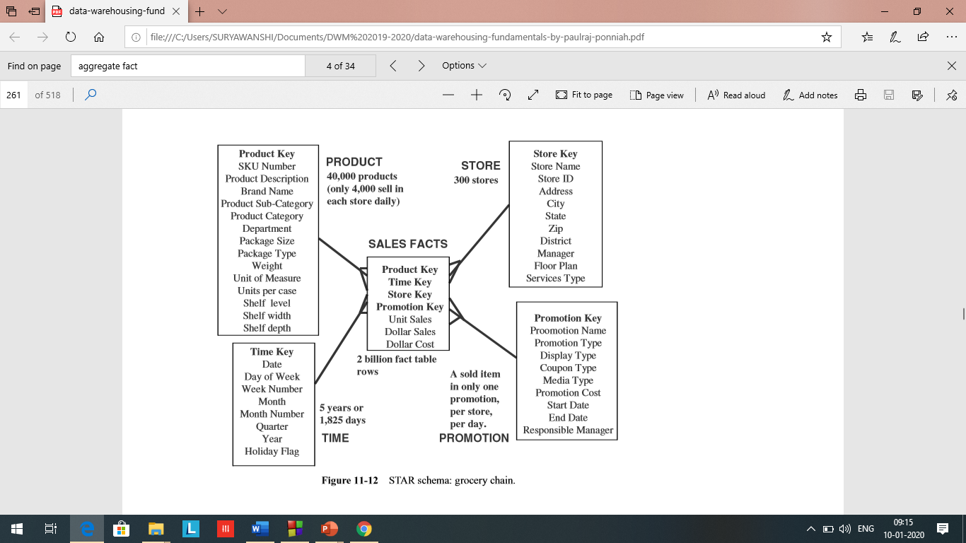
Time dimension: 5 years × 365 days = 1825
Store dimension: 300 stores reporting daily sales
Product dimension: 40,000 products in each store (about 4000 sell in each store daily) Promotion dimension: a sold item may be in only one promotion in a store on a given day Maximum number of base fact table records: 1825 × 300 × 4000 × 1 = 2 billion

Slide 51
Here are a few more estimates of the fact table sizes in other typical cases:
Telephone Call Monitoring
Time dimension: 5 years = 1825 days
Number of calls tracked each day: 150 million
Maximum number of base fact table records: 274 billion
Credit Card Transaction Tracking
Time dimension: 5 years = 60 months
Number of credit card accounts: 150 million
Average number of monthly transactions per account: 20
Maximum number of base fact table records: 180 billion
From the above examples you see the typical enormity of the fact tables that are at the lowest level of granularity.

Slide 52
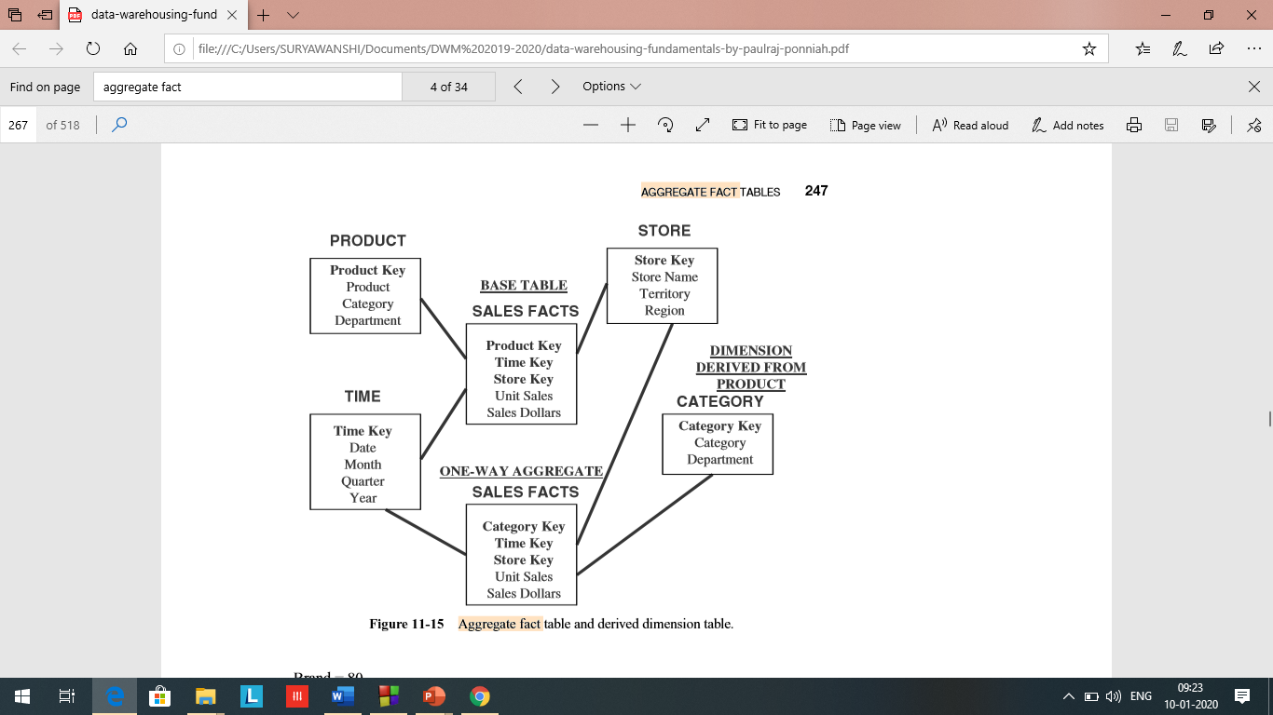

Slide 53
Although none of the queries from the users would call for data just from a single row in these fact tables, data at the lowest level of detail is needed. This is because when a user performs various forms of analysis, he or she must be able to get result sets comprising of a variety of combinations of individual fact table rows.

Slide 54
Benefit of Having aggregate tables
Aggregates have fewer rows than the base tables. Therefore, when most of the queries are run against the aggregate fact tables instead of the base fact table, you notice a tremendous boost to performance in the data warehouse. Formation of aggregate fact tables is certainly a very effective method to improve query performance.

Slide 55
SUMMARY
Slowly changing dimensions may be classified into three different types based on the nature of the changes. Type 1 relates to corrections, Type 2 to preservation of history, and Type 3 to soft revisions. Applying each type of revision to the data warehouse is different.
Large dimension tables such as customer or product need special considerations for applying optimizing techniques.
“Snowflaking” or creating a snowflake schema is a method of normalizing the STAR schema. Although some conditions justify the snowflake schema, it is generally not recommended.
Miscellaneous flags and textual data are thrown together in one table called a junk dimension table.
Aggregate or summary tables improve performance. Formulate a strategy for building aggregate tables

